Slide 1
CHAPTER
21
The Theory of
Consumer Choice
Notes:
This chapter covers topics considered advanced for the typical principles course: budget constraints, indifference curves, household optimization, and the income and substitution effects of price changes.
Most students find it more difficult than average.
The first half of the chapter develops the theory. The second half applies the theory to three consumer choice problems:
1) Giffen goods and positively-sloped demand curves
2) The labor–leisure choice
3) The effects of interest rates on household saving
The first half of this PowerPoint chapter uses a different example than the text, with different numerical values. (The applications in the second half are as in the textbook.)

Slide 2
Look for the answers to these questions:
How does the budget constraint represent the choices a consumer can afford?
How do indifference curves represent the consumer’s preferences?
What determines how a consumer divides her resources between two goods?
How does the theory of consumer choice explain decisions such as how much a consumer saves, or how much labor she supplies?

Slide 3
Introduction
People face tradeoffs.
Buying more of one good leaves less income to buy other goods
Working more hours means more income and more consumption, but less leisure time
Reducing saving allows more consumption today but reduces future consumption
This chapter explores how consumers make choices like these.

Slide 4
The Budget Constraint: What the Consumer Can Afford
Budget constraint:
The limit on the consumption bundles that a consumer can afford
Example:
Hurley divides his income between two goods: fish and mangos.
A “consumption bundle” is a particular combination of the goods, e.g., 40 fish & 300 mangos
Notes:
The two-good assumption greatly simplifies the analysis without altering the basic insights about consumer choice.
If your students remember the Production Possibilities Frontier, you might tell them that a budget constraint is, in essence, a “consumption possibilities frontier” for the consumer: it shows all combinations (bundles) of the two goods that the consumer can afford to buy.

Slide 5
Active Learning 1 The budget constraint
Hurley’s income: $1200
Prices: P_{F} = $4 per fish, P_{M} = $1 per mango
If Hurley spends all his income on fish, how many fish does he buy?
If Hurley spends all his income on mangos, how many mangos does he buy?
If Hurley buys 100 fish, how many mangos can he buy?
Plot each of the bundles from parts A – C on a graph that measures fish on the horizontal axis and mangos on the vertical; connect the dots.
Notes:
A very straightforward exercise.

Slide 6
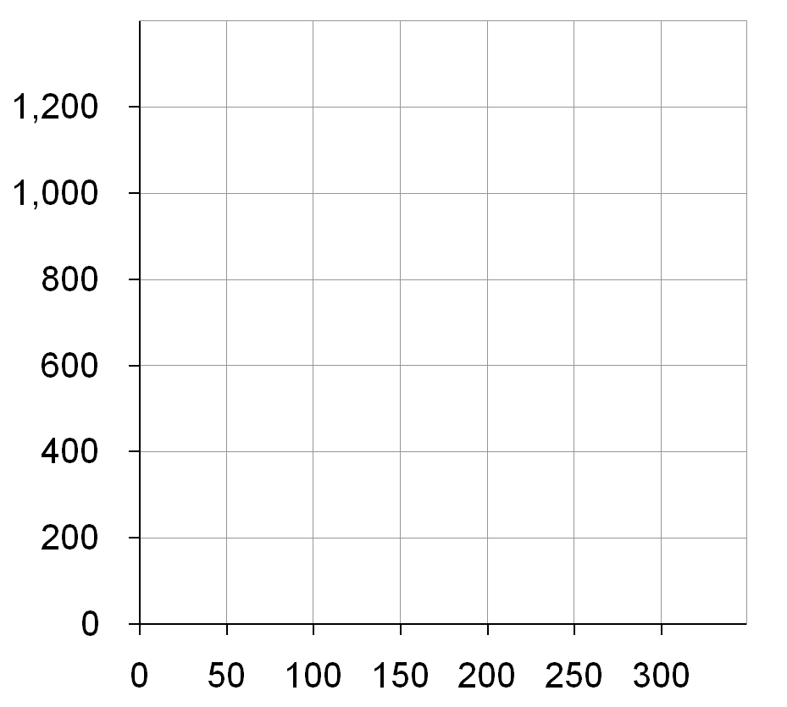
Active Learning 1 Answers
A. $1200/$4 = 300 fish
B. $1200/$1 = 1200 mangos
C. 100 fish cost $400, $800 left buys 800 mangos
D. Hurley’s budget constraint shows the bundles he can afford.
Quantity of Mangos
B
C
A
Quantity of Fish

Slide 7
Active Learning 1 The Slope of the Budget Constraint
Quantity of Mangos
The slope of the budget constraint equals the relative price of the good on the X axis.
From C to D,
“rise” = –200 mangos
“run” = +50 fish
Slope = – 4
Hurley must give up 4 mangos to get one fish.
C
D
Quantity of Fish

Slide 8
Active Learning 2 The budget constraint, continued
Initial problem:
Hurley’s income: $1200
Prices: P_{F} = $4 per fish, P_{M} = $1 per mango
Show what happens to Hurley’s budget constraint if:
His income falls to $800.
The price of mangos rises to P_{M} = $2 per mango
Notes:
Another straightforward problem that will not take much class time. Yet, students will learn these concepts better by figuring out for themselves how the budget line moves in response to income and price changes.

Slide 9
Active Learning 2 Answers, part A
Now, Hurley can buy
$800/$4 = 200 fish
or $800/$1 = 800 mangos
or any combination in between.
Quantity of Mangos
A fall in income shifts the budget constraint down.
Quantity of Fish

Slide 10
Active Learning 2 Answers, part B
Hurley can still buy 300 fish.
But now he can only buy $1200/$2 = 600 mangos.
Notice: slope is smaller, relative price of fish is now only 2 mangos
Quantity of Mangos
An increase in the price of one good pivots the budget constraint inward.
Quantity of Fish

Slide 11
Preferences: What the Consumer Wants
Indifference curve: shows consumption bundles that give the consumer the same level of satisfaction
A, B, and all other bundles on I₁ make Hurley equally happy: he is indifferent between them.
One of Hurley’s indifference curves
Quantity of Mangos
B
A
I₁
Quantity of Fish

Slide 12
Four Properties of Indifference Curves 1. Indifference curves are downward-sloping.
One of Hurley’s indifference curves
Quantity of Mangos
If the quantity of fish is reduced,
the quantity of mangos must be increased to keep Hurley equally happy.
B
A
I₁
Quantity of Fish

Slide 13
Four Properties of Indifference Curves 2. Higher indifference curves are preferred to lower ones.
A few of Hurley’s indifference curves
Quantity of Mangos
Hurley prefers every bundle on I₂ (like C) to every bundle on I₁ (like A).
He prefers every bundle on I₁ (like A) to every bundle on I₀ (like D).
C
D
A
I₂
I₁
I₀
Quantity of Fish

Slide 14
Four Properties of Indifference Curves 3. Indifference curves cannot cross.
Suppose they did.
Hurley should prefer B to C, since B has more of both goods.
Yet, Hurley is indifferent between B and C:
He likes C as much as A (both are on I₄).
He likes A as much as B (both are on I₁).
Hurley’s indifference curves
Quantity of Mangos
B
C
A
I₁
I₄
Quantity of Fish

Slide 15
Four Properties of Indifference Curves 4. Indifference curves are bowed inward.
Quantity of Mangos
Hurley is willing to give up more mangos for a fish if he has few fish (A) than if he has many (B).
A
6
1
B
2
1
I₁
Quantity of Fish
Notes:
Hurley has more fish at B than at A, so an extra fish would be less valuable at B than at A.

Slide 16
The Marginal Rate of Substitution
Marginal rate of substitution (MRS): the rate at which a consumer is willing to
trade one good for another.
Hurley’s MRS is the amount of mangos he would substitute for another fish.
MRS falls as you move down along an indifference curve.
MRS = slope of indifference curve
Quantity of Mangos
A
MRS =
6
1
B
MRS =
2
1
I₁
Quantity of Fish
Notes:
At A, Hurley has few fish, so an additional fish is very valuable to him.
At B, Hurley already has lots of fish, so an additional one is not as valuable to him.

Slide 17
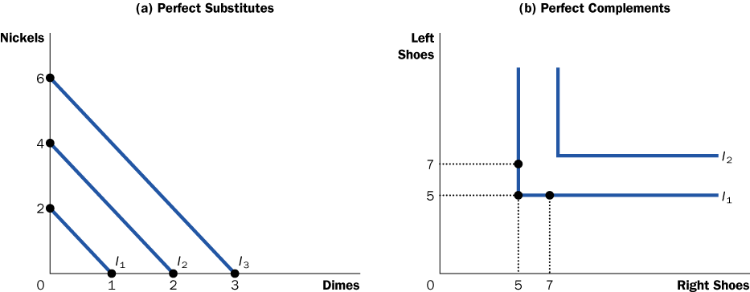
One Extreme Case: Perfect Substitutes
Perfect substitutes: two goods with straight-line indifference curves, constant MRS
Example: nickels and dimes
Consumer is always willing to trade two nickels for one dime.
Notes:
17
It is hard to think of examples of perfect substitutes. (Even nickels and dimes are probably not perfect substitutes: I’d rather carry 10 dimes in my pocket than 20 nickels.)
But it’s easy to think of examples that are close substitutes, and therefore are likely to have indifference curves that are not very bowed:
1) Movies (at the movie theater) and videos at home. A consumer might be willing to trade two videos for one night at the movies.
2) Coke and Pepsi (for consumers who do not perceive much difference between them).
3) Vacations in Hawaii and vacations in the Bahamas.

Slide 18
Another Extreme Case: Perfect Complements
Perfect complements: two goods with right-angle indifference curves
Example: Left shoes, right shoes
{7 left shoes, 5 right shoes}
is just as good as
{5 left shoes, 5 right shoes}
Notes:
18
Again, It is hard to think of examples of perfect complements. But it’s easy to think of examples that are good though not perfect complements, and therefore are likely to have indifference curves that are very bowed:
1) Tickets to rock concerts and parking at the arena in which the concert takes place.
2) Hot dogs and hot dog buns.
3) Brewed Starbucks coffee and 20 spoons of sugar (If you don’t get this one, you probably haven’t tried brewed Starbucks coffee!).

Slide 19
Less Extreme Cases: Close Substitutes and Close Complements
Indifference curves for close substitutes are not very bowed
Quantity of hot dog buns
Indifference curves for close complements are very bowed
Quantity of Pepsi
Quantity of Coke
Quantity of hot dogs
Notes:
When the two goods are close but not perfect substitutes (like Coke and Pepsi), indifference curves are slightly bowed.
When the two goods are close but not perfect complements (like hot dogs and buns), indifference curves are very bowed, having a very sharp (but not quite 90-degree) angle.
Later in this PowerPoint chapter, an Active Learning exercise asks students to illustrate the substitution effect for these two cases. They will see that a relative price change causes a much bigger movement along an indifference curve when the goods are substitutes than when they are complements.

Slide 20
Optimization: What the Consumer Chooses
Quantity of Mangos
A is the optimum: the point on the budget constraint that touches the highest possible indifference curve.
Hurley prefers B to A, but he cannot afford B.
Hurley can afford C and D, but A is on a higher indifference curve.
The optimum is the bundle Hurley most prefers out of all the bundles he can afford.
1200
B
A
600
C
D
150
300
Quantity of Fish
Notes:
Simply put, optimization means buying the bundle that makes the consumer happiest, given his or her income.

Slide 21
Optimization: What the Consumer Chooses
Quantity of Mangos
Consumer optimization is another example of “thinking at the margin.”
At the optimum,
slope of the indifference curve equals slope of the budget constraint:
1200
MRS = P_{F} / P_{M}
A
600
marginal value of fish (in terms of mangos)
price of fish (in terms of mangos)
150
300
Quantity of Fish
Notes:
Consumer optimization is another example of “thinking at the margin.”
Remember that MRS = marginal value of the good on the X-axis (fish) in terms of the good on Y-axis (mangos).
If MRS > Pf/Pm, the value of another fish is greater than its cost, so Hurley can make himself happier by decreasing his mango purchases and using the proceeds to buy another fish.
If MRS < Pf/Pm, the value of another fish is less than its cost, so Hurley should move along his budget line to a bundle with less fish and more mangos to make himself happier.

Slide 22
The Effects of an Increase in Income
An increase in income shifts the budget constraint outward.
If both goods are “normal,” Hurley buys more of each.
Quantity of Mangos
B
A
Quantity of Fish
Notes:
In Active Learning 2, students determined that a fall in income shifts the budget constraint downward. They should readily accept, then, that an increase in income shifts the budget line upward/outward.

Slide 23
Active Learning 3 Inferior vs. normal goods
An increase in income increases the quantity demanded of normal goods and reduces the quantity demanded of inferior goods.
Suppose fish is a normal good but mangos are an inferior good.
Use a diagram to show the effects of an increase in income on Hurley’s optimal bundle of fish and mangos.
Notes:
Instead of merely showing students the diagram for the case where one of the goods is inferior, let’s just remind them of the definition and see if they can figure out how to draw the diagram.

Slide 24
Active Learning 3 Answers
Quantity of Mangos
If mangos are inferior, the new optimum will contain fewer mangos.
A
B
Quantity of Fish

Slide 25
The Effects of a Price Change
Initially,
P_{F} = $4
P_{M} = $1
P_{F} falls to $2
budget constraint rotates outward,
Hurley buys more fish and fewer mangos.
Quantity of Mangos
1200
initial optimum
new optimum
600
500
150
300
600
Quantity of Fish
350
Notes:
In Active Learning 2, students determined that an increase in the price of a good pivots the budget constraint inward. Here, the price of a good is falling, so the budget line pivots outward.

Slide 26
The Income and Substitution Effects
A fall in the price of fish has two effects on Hurley’s optimal consumption of both goods
Income effect
A fall in P_{F} boosts the purchasing power of Hurley’s income: buy more mangos and more fish
Substitution effect
A fall in P_{F} makes mangos more expensive relative to fish: Hurley buys fewer mangos and more fish
The net effect on mangos is ambiguous.
Notes:
On the previous slide, the fall in the price of fish caused a net decrease in Hurley’s demand for mangos: the substitution effect is greater than the income effect, as depicted on the following slide.
However, it could have gone the other way: if the income effect were greater than the substitution effect, then Hurley’s demand for mangos would have risen.

Slide 27
The Income and Substitution Effects
Quantity of Mangos
Initial optimum at A.
P_{F} falls.
Substitution effect: from A to B, buy more fish and fewer mangos.
Income effect: from B to C, buy more of both goods.
In this example, the net effect on mangos is negative.
A
C
B
Quantity of Fish
Notes:
This diagram decomposes the movement from the old optimum (A) to the new one (C) into two parts.
The first part, from A to B, represents the substitution effect. It shows the change in the optimal bundle due to the relative price change, holding constant the consumer’s level of well-being.
The second part, from B to C, represents the income effect. It shows the change in the optimal bundle due to the increase in the purchasing power of the consumer’s income. The dashed line through point B is parallel to the new budget line through point C, indicating that we are holding relative prices constant to see how the increase in income affects the optimal bundle.

Slide 28
Active Learning 4 The substitution effect in two cases
Do you think the substitution effect would be bigger for substitutes or complements?
Draw an indifference curve for Coke and Pepsi, and, on a separate graph, one for hot dogs and hot dog buns.
On each graph, show the effects of a relative price change (keeping the consumer on the initial indifference curve).
Notes:
This exercise is similar to Problem 2 in the back of the chapter.
It reviews these concepts:
indifference curves for substitutes and complements have different shapes
the substitution effect shows the movement along an indifference curve from a relative price change

Slide 29
Active Learning 4 Answers
But the substitution effect is bigger for substitutes than for complements.
In both graphs, the relative price changes by the same amount.
Quantity of Pepsi
Quantity of hot dog buns
A
A
B
B
Quantity of Coke
Quantity of hot dogs

Slide 30
Deriving Hurley’s Demand Curve for Fish
A: When P_{F} = $4, Hurley demands 150 fish.
B: When P_{F} = $2,
Hurley demands 350 fish.
Quantity of Mangos
Price of Fish
A
$4
A
B
B
$2
D_{Fish}
150
350
Quantity of Fish
150
350
Quantity of Fish
Notes:
This slide shows that the familiar demand curve we’ve been using all semester comes from consumer optimization.

Slide 31
Application 1: Giffen Goods
Do all goods obey the Law of Demand?
Suppose the goods are potatoes and meat, and potatoes are an inferior good.
If price of potatoes rises,
Substitution effect: buy less potatoes
Income effect: buy more potatoes
If income effect > substitution effect, then potatoes are a Giffen good, a good for which an increase in price raises the quantity demanded.

Slide 32
Application 1: A Giffen Good
Quantity of
Potatoes
Initial budget
constraint
1. An increase in the price of potatoes rotates the budget constraint inward . . .
B
D
Optimum with high
price of potatoes
New
budget
constraint
2. . . . which increases potato consumption if potatoes are a Giffen good.
E
C
Optimum with low
price of potatoes
I₁
I₂
A
0
Quantity of Meat
In this example, when the price of potatoes rises, the consumer’s optimum shifts from point C to point E. In this case, the consumer responds to a higher price of potatoes by buying less meat and more potatoes.
Notes:
This is Figure 12 from the text.
An increase in the price of potatoes rotates the budget line inward.
The substitution effect would cause the consumer to buy fewer potatoes. Imagine moving down along indifference curve I₁ until reaching the point where its slope just equals the slope of the new budget line. At that point, demand for potatoes is lower, because consumers are substituting meat for potatoes.
But if potatoes are an inferior good, the income effect causes demand for potatoes to rise: the price increase makes the consumer generally worse off. The consumer responds by buying less meat (the normal good) and more potatoes (the inferior good).
If potatoes are a Giffen good, the income effect exceeds the substitution effect, so the net effect of a price increase on demand for potatoes is positive!!!
As the book notes, Giffen goods are extremely rare—if they exist at all.

Slide 33
Application 2: Wages and Labor Supply
Budget constraint
Shows a person’s tradeoff between consumption and leisure
Depends on how much time she has to divide between leisure and working
The relative price of an hour of leisure is the amount of consumption she could buy with an hour’s wages
Indifference curve
Shows “bundles” of consumption and leisure that give her the same level of satisfaction

Slide 34
Application 2: Wages and Labor Supply
Consumption
$5,000
At the optimum, the MRS between leisure and consumption equals the wage.
Optimum
I₃
2,000
I₂
I₁
0
60
100
Hours of leisure
Notes:
This is Figure 13 from the text.
Here, the marginal rate of substitution measures the marginal value of an hour of leisure, in terms of (dollars’ worth of) consumption.
The slope of the budget line simply equals the wage: each additional hour of leisure requires working one fewer hour, which causes consumption to fall by an hour’s wages.
At the optimum, the marginal value of leisure (in terms of consumption) must equal the relative price of leisure (in terms of consumption), or the wage.
If MRS > wage, then the value of leisure is greater than its price, so take more leisure (and work fewer hours) to raise happiness.
If MRS < wage, then the value of leisure is less than its price, so take less leisure (and work more hours) to raise happiness.

Slide 35
Application 2: Wages and Labor Supply
An increase in the wage has two effects on the optimal quantity of labor supplied:
Substitution effect (SE): A higher wage makes leisure more expensive relative to consumption.
The person chooses less leisure (increases quantity of labor supplied)
Income effect (IE): With a higher wage, she can afford more of both “goods.”
She chooses more leisure (reduces quantity of labor supplied)
Notes:
The relative magnitude of the substitution and income effects determine the slope of the labor supply curve, as the following slides show.

Slide 36
Application 2: Wages and Labor Supply
For this person, SE > IE
So her labor supply increases with the wage
Consumption
Wage
BC₂
Labor supply
B
I₂
1. When the wage rises . . .
BC₁
A
I₁
0
0
Hours of Leisure
Hours of Labor
Supplied
2. . . . hours of leisure decrease . . .
3. . . . and hours of labor increase
Notes:
This is Figure 14 (a) from the text.
A person with the preferences depicted in the left graph will have a positively-sloped labor supply curve, as shown in the right graph.

Slide 37
Application 2: Wages and Labor Supply
For this person, SE < IE
So his labor supply falls when the wage rises
Consumption
Wage
BC₂
Labor supply
1. When the wage rises . . .
I₂
I₁
BC₁
0
0
Hours of Leisure
Hours of Labor
Supplied
2. . . . hours of leisure increase . . .
3. . . . and hours of labor decrease
Notes:
This is Figure 14 (b) from the text.
A person with the preferences depicted in the left graph will have a negatively-sloped labor supply curve, as shown in the right graph.

Slide 38
Could This Happen in the Real World???
Cases where the income effect on labor supply is very strong:
Over last 100 years, technological progress has increased labor demand and real wages.
The average workweek fell from 6 to 5 days.
When a person wins the lottery or receives an inheritance, his wage is unchanged—hence no substitution effect.
But such persons are more likely to work fewer hours, indicating a strong income effect
Notes:
Typically, we assume the substitution effect is at least as big as the income effect, and we draw labor supply curves as upward-sloping or perhaps vertical.
This slide notes examples from a case study in this chapter in which the income effect is very strong.
I would add an additional possibility (not mentioned in the book): A person’s labor supply curve may slope upward for low wages, become steeper, and bend backward at high wages. Here’s why:
The size of the substitution effect depends on a comparison of the wage to the marginal rate of substitution between leisure and consumption. The higher the wage relative to the MRS, the stronger the incentive to substitute away from leisure and toward consumption.
As a person works more hours, consumption becomes more plentiful while leisure becomes dearer. The marginal value of leisure rises relative to consumption. I.e., the MRS rises as the person moves up an indifference curve.
As this occurs, it takes increasingly large wage increases to make the person willing to sacrifice another hour of leisure. I.e., the substitution effect from a given increase in the wage gets weaker.
Meanwhile, the income effect is as strong as ever—a person with very high wages can afford to take more time off than a person with lower wages.

Slide 39
Application 3: Interest Rates and Saving
A person lives for two periods.
Period 1: young, works, earns $100,000, consumption = $100,000 minus amount saved
Period 2: old, retired, consumption = saving from Period 1 plus interest earned on saving
The interest rate
Determines the relative price of consumption when young in terms of consumption when old
Notes:
Why the interest rate determines the relative price of current in terms of future consumption:
If you reduce current consumption by $1, and save this $1, then your future consumption will rise by $(1 + r), where r denotes the interest rate.
Similarly, if you wish to increase current consumption by $1, then you must sacrifice the $(1 + r) that you would have been able to consume in the future.
Notice that the slide does not say “the interest rate equals the relative price…”. In fact, the relative price of current in terms of future consumption (and also the slope of the budget constraint) equals (1 + r), not r.

Slide 40
Application 3: Interest Rates and Saving
Consumption
when Old
Budget constraint shown is for 10% interest rate.
At the optimum, the MRS between current and future consumption equals the interest rate.
$110,000
Optimum
55,000
I₃
I₂
I₁
0
$50,000
100,000
Consumption when Young
Notes:
This is Figure 15 from the text.
The marginal rate of substitution is the marginal value of current consumption in terms of future consumption; it tells you how much future consumption the person is willing to give up for a unit of current consumption.
If the consumer is optimizing, then the MRS must equal (1 + r): the marginal value of current consumption must equal the relative price of current consumption (both in terms of future consumption).
If MRS were not equal to (1 + r), then the consumer could increase his satisfaction by changing his level of saving (and hence, his “bundle” of current and future consumption).

Slide 41
Active Learning 5 A change in the interest rate
Suppose the interest rate rises.
Describe the income and substitution effects on current and future consumption, and on saving.
Notes:
This exercise gives students practice identifying and interpreting the income and substitution effects in a new context.

Slide 42
Active Learning 5 Answers
The interest rate rises.
Substitution effect
Current consumption becomes more expensive relative to future consumption.
Current consumption falls, saving rises, future consumption rises.
Income effect
Can afford more consumption in both the present and the future.
Saving falls.
Notes:
After you display the full contents of the slide, point out that future consumption unambiguously rises. However, the effects on current consumption and saving depend on which of the income and substitution effects is bigger.
The following slides show the two cases.

Slide 43
Application 3: Interest Rates and Saving
(a) Higher Interest Rate Raises Saving
Consumption
when
old
BC₂
1. A higher interest rate rotates the budget constraint outward . . .
In this case, SE > IE and saving rises
2. . . . resulting in lower consumption when young and, thus, higher saving.
I₂
BC₁
I₁
0
Consumption when Young
Notes:
This is Figure 16 (a ) from the text.
The macro chapters of Mankiw’s Principles of Economics typically assume that saving is positively related to the interest rate, as depicted here.

Slide 44
Application 3: Interest Rates and Saving
(b) Higher Interest Rate Lowers Saving
Consumption
when
old
BC₂
1. A higher interest rate rotates the budget constraint outward . . .
In this case, SE < IE and saving falls
I₂
2. . . . resulting in higher consumption when young and, thus, lower saving.
I₁
BC₁
0
Consumption when Young
Notes:
This is Figure 16 (b) from the text.
If the income effect is bigger than the substitution effect, then an increase in the interest rate would reduce saving, not increase it.

Slide 45
Conclusion: Do People Really Think This Way?
People do not make spending decisions by writing down their budget constraints and indifference curves.
Yet, they try to make the choices that maximize their satisfaction given their limited resources.
The theory in this chapter is only intended as a metaphor for how consumers make decisions.
It explains consumer behavior fairly well in many situations and provides the basis for more advanced economic analysis.

Slide 46
Summary
A consumer’s budget constraint shows the possible combinations of different goods she can buy given her income and the prices of the goods.
The slope of the budget constraint equals the relative price of the goods.
An increase in income shifts the budget constraint outward.
A change in the price of one of the goods pivots the budget constraint.

Slide 47
Summary
A consumer’s indifference curves represent her preferences.
An indifference curve shows all the bundles that give the consumer a certain level of happiness.
The consumer prefers points on higher indifference curves to points on lower ones.
The slope of an indifference curve at any point is the marginal rate of substitution
MRS = rate at which the consumer is willing to trade one good for the other.

Slide 48
Summary
The consumer optimizes by choosing the point on her budget constraint that lies on the highest indifference curve.
At this point, the marginal rate of substitution equals the relative price of the two goods.
When the price of a good falls, the impact on the consumer’s choices can be broken down into two effects, an income effect and a substitution effect.

Slide 49
Summary
The income effect is the change in consumption that arises because a lower price makes the consumer better off.
Movement from a lower indifference curve to a higher one.
The substitution effect is the change that arises because a price change encourages greater consumption of the good that has become relatively cheaper.
Movement along an indifference curve.

Slide 50
Summary
The theory of consumer choice can be applied in many situations.
It can explain why demand curves can potentially slope upward, why higher wages could either increase or decrease labor supply, and why higher interest rates could either increase or decrease saving.

